Slide 1
Earth Lab Workflow Processes
Shelley Knuth, Timothy Dunn, Maxwell Joseph
Earth Lab, Research Computing, University of Colorado-Boulder
shelley.knuth@colorado.edu

Slide 2
Survey!
https://cuboulder.qualtrics.com/SE/?SID=SV_cVijgPRRuX3Nhop

Slide 3
Outline
What resources does Earth Lab have access to?
Infrastructure
Technical Team
How does the Earth Lab team access these resources?
General operations and workflow

Slide 4
Resource Description

Slide 5
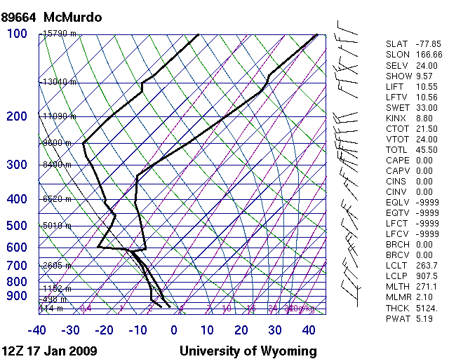
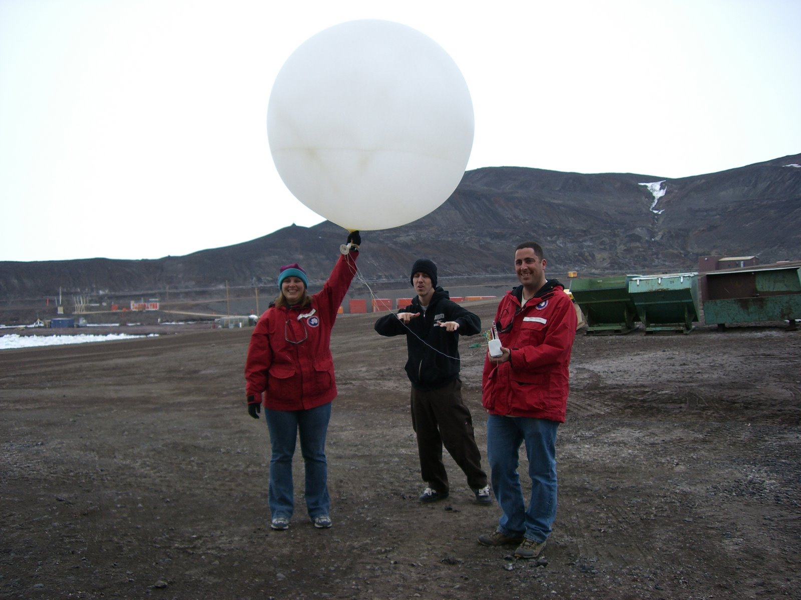
Overarching Issue
Research scientists solve science problems
Must work on technical problems
Data formats, transfer, integration
Programming
Data mining, data visualization
Lack of training

Slide 6
The Analytics Hub
One mission of Earth Lab is to provide a technical platform to allow scientists better perform their research
The Analytics Hub
Existing infrastructure with new tools and expertise to make this happen
Three key components:
People
Data visualization
Data analytics

Slide 7
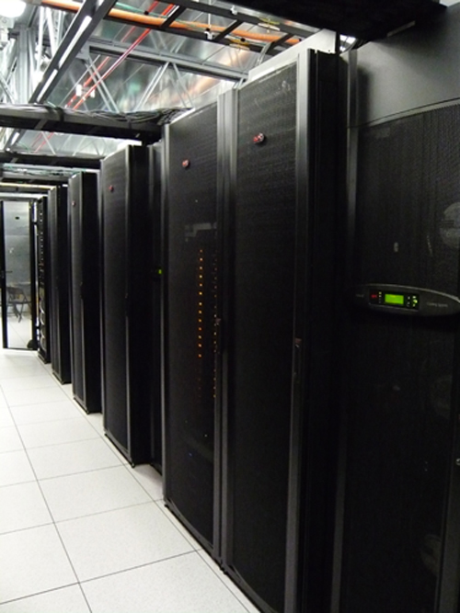
What Is the Analytics Hub?
A platform to perform science easier
Access to large scale computing and storage
User-friendly interfaces
Don’t need to understand details
Code recipes
Built by Earth Lab for Earth Lab
Testing phase
http://www.colorado.edu/earthlab/analytics-hub

Slide 8
Architecture of Analytics Hub

Slide 9
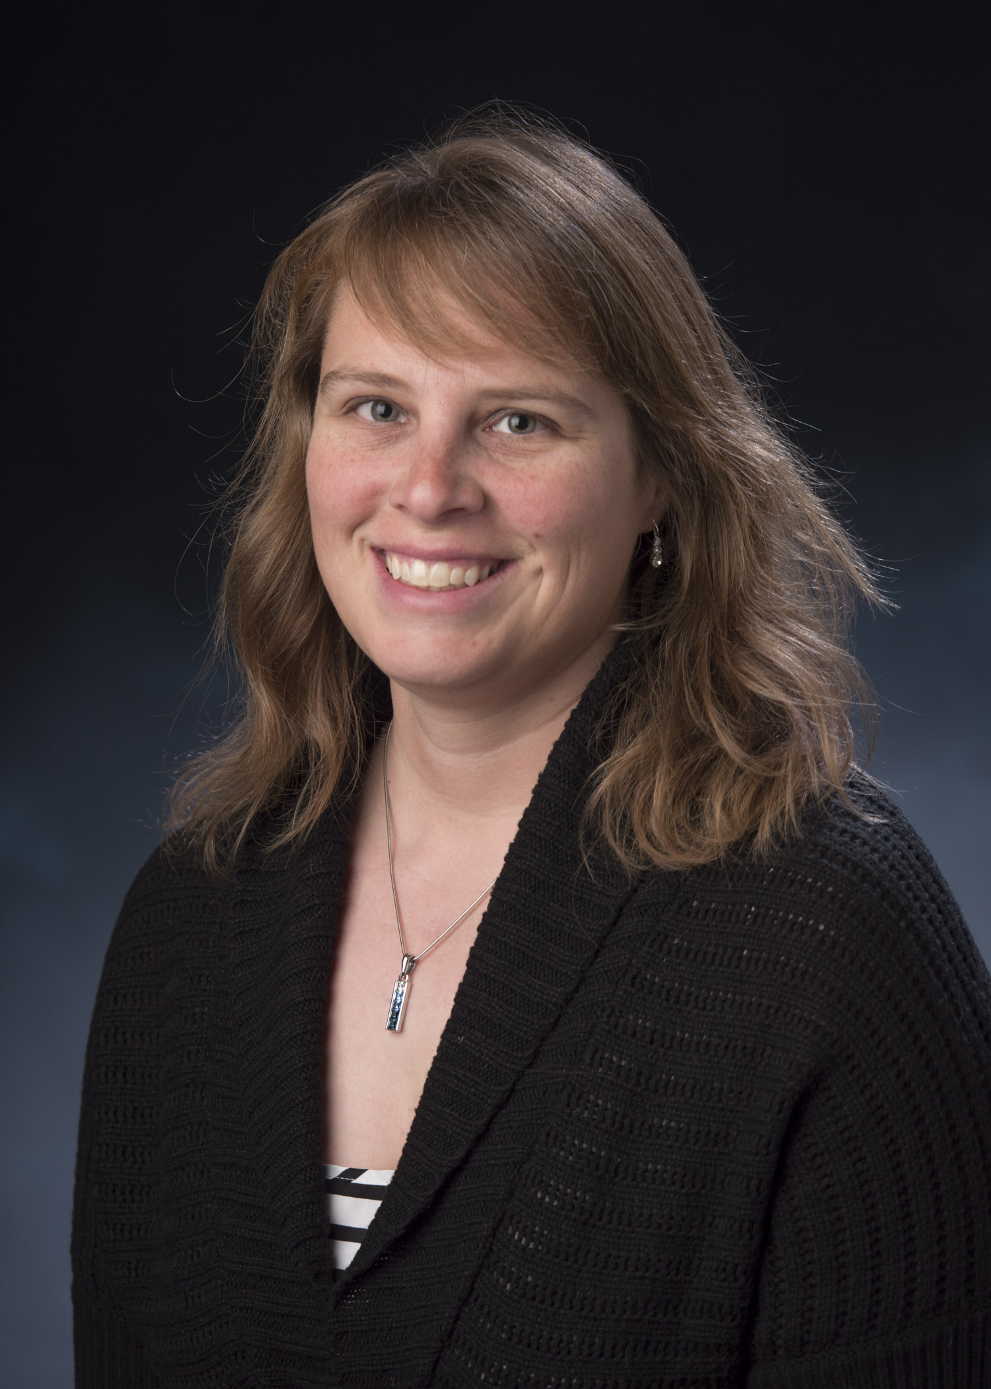
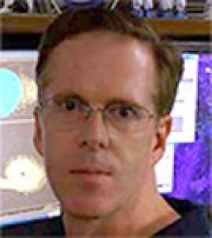
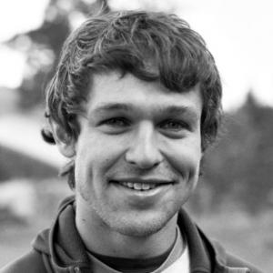
Technical Team
Shelley Knuth – Director
Tim Dunn – Visualization
Max Joseph – Analytics
Zach Schira – Intern
Matt Oakley - Intern
Shelley Knuth
Max Joseph
Tim Dunn

Slide 10
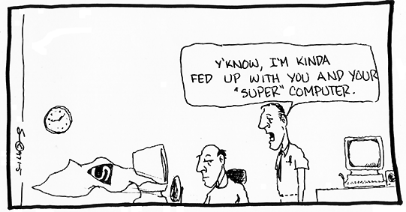
Understanding the Cyberinfrastructure
AH rests on existing infrastructure
Managed by Research Computing
PetaLibrary
Janus supercomputer

Slide 11
PetaLibrary
960 TB data storage infrastructure
Large scale data
Space on Active (spinning disk) or Archive (tape)
Mounted on Janus

Slide 12
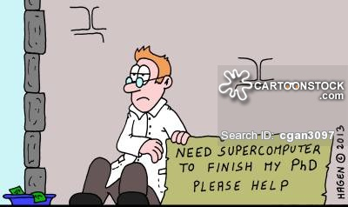
Janus, etc.
Janus
1368 compute nodes (Dell C6100)
16,428 total cores
Infiniband network
High memory nodes
Graphics Processing Units
Large scale data transfer
ScienceDMZ
80 Gb/s network
Not competing with lower level network demands like YouTube, etc.

Slide 13
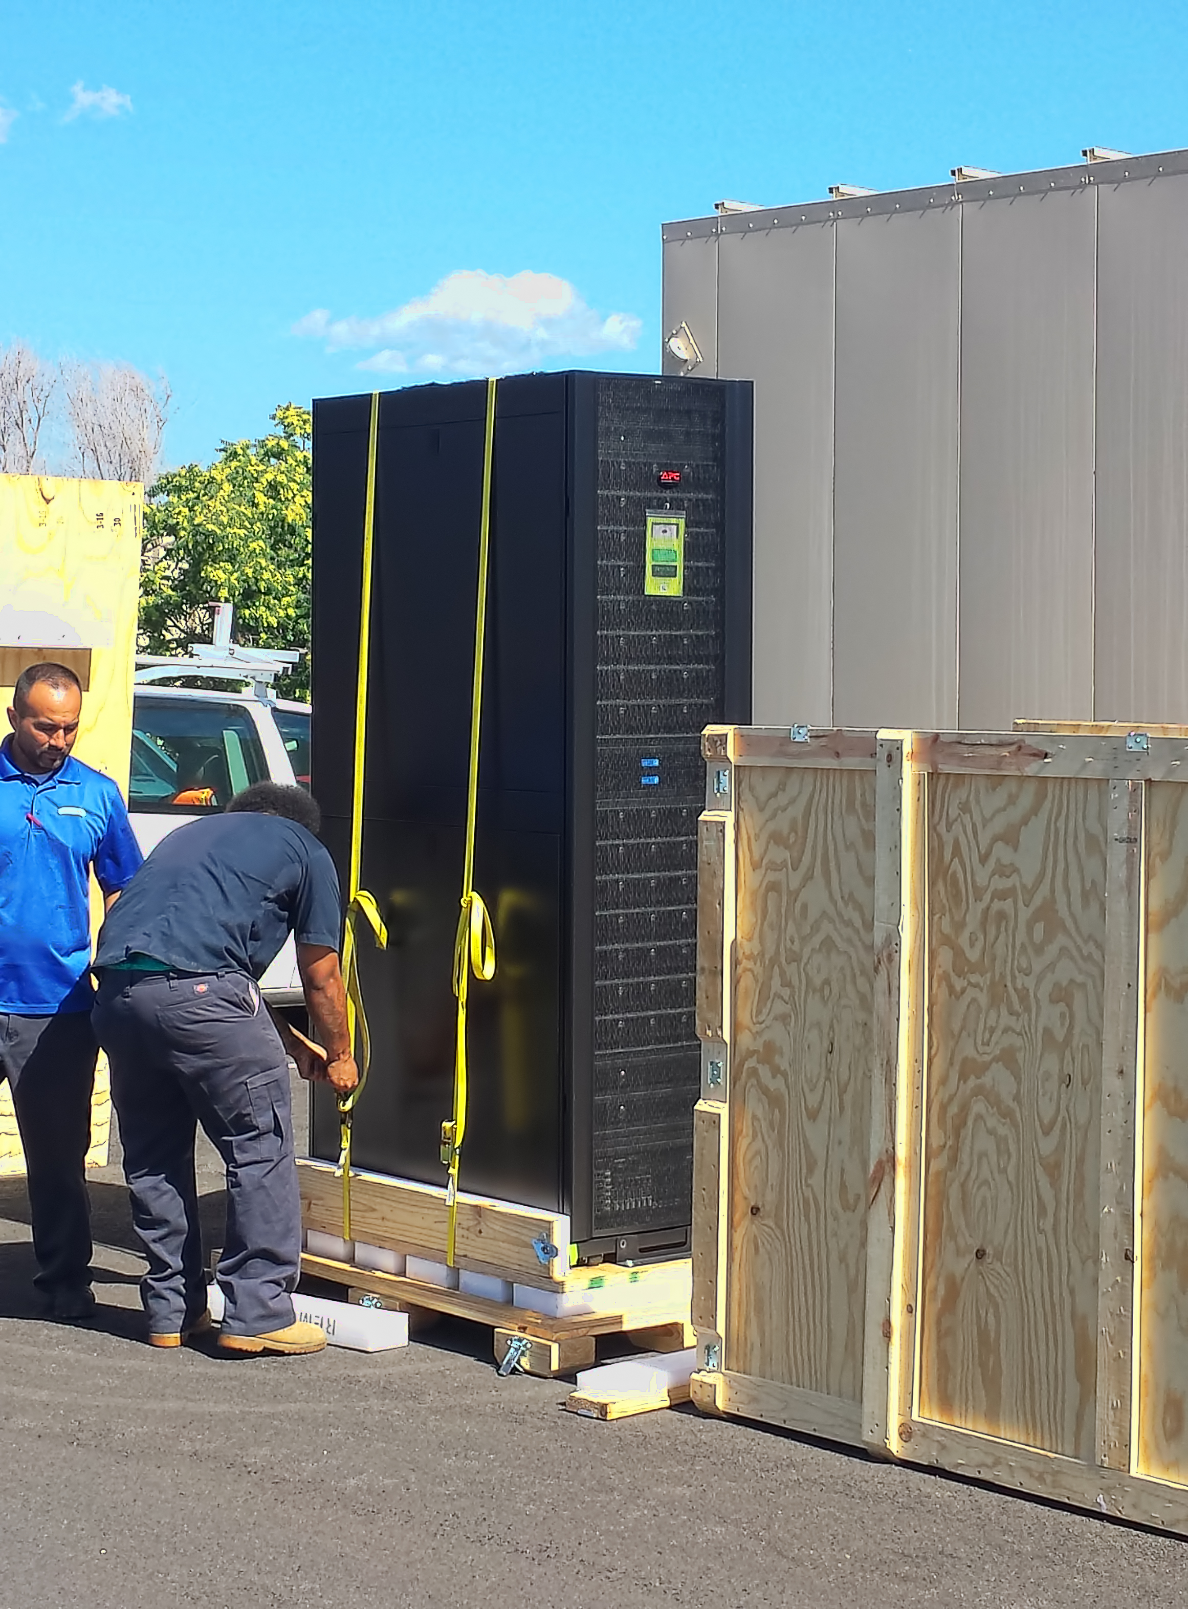
Summit: CU-Boulder’s Next Supercomputer
Joint between CU-Boulder and CSU
Installed and running by fall semester 2016
Any CU-Boulder researcher
Peak performance ~450 TFLOPS
JANUS – 170 TFLOPS
5-year lifetime
Dell principal vendor
Credit: Tim Dunn
Notes:
$2.7M combined grant award; $3.5M total purchase price; difference made up by institutional matching funds
Will be installed in CU's HPCF

Slide 14
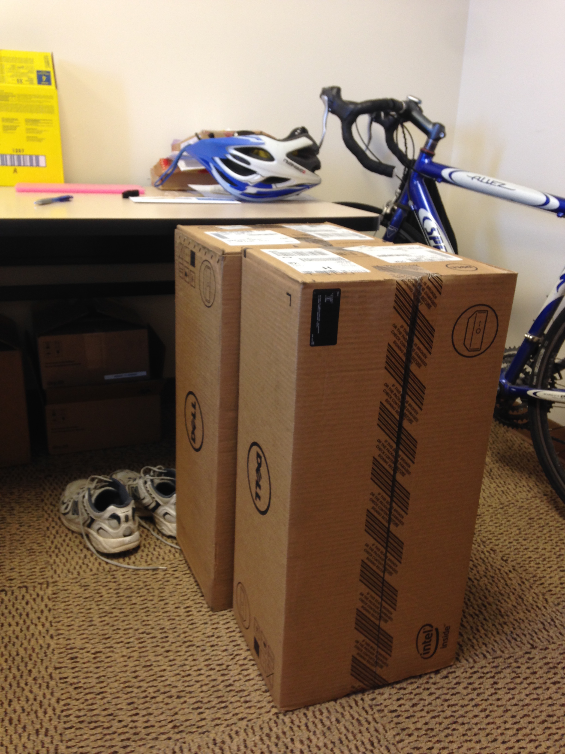
Dedicated Compute - Condo Clusters
Groups can purchase compute nodes as part of a cluster called “Blanca”
Priority for owner
All other nodes available
Maximum 4 hour wait
Earth Lab purchased two nodes

Slide 15
Architecture of Analytics Hub

Slide 16
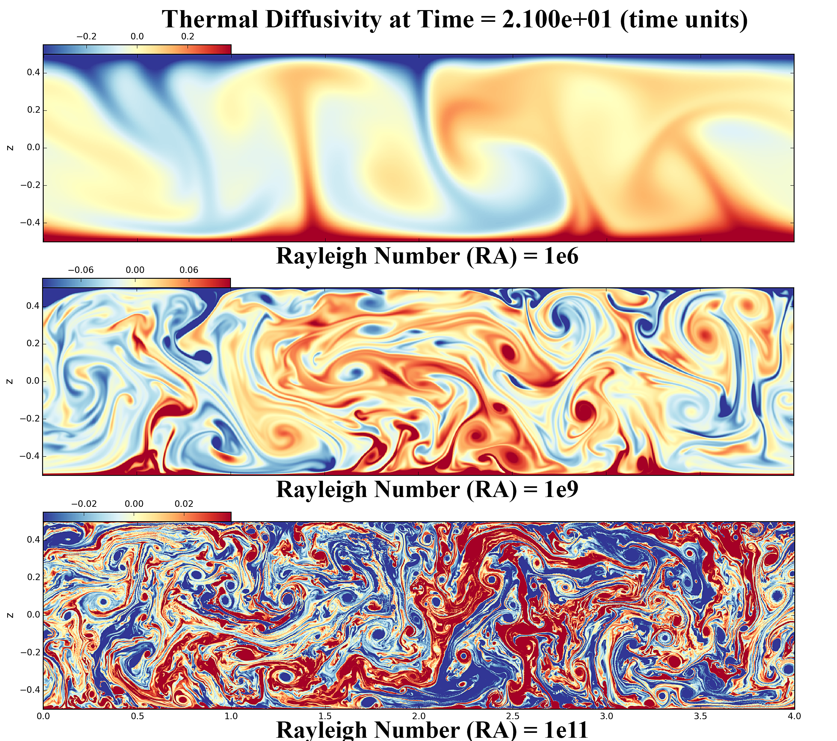
Data Visualization - NICE
Remote visualization platform
Software on GPUs that are part of the supercomputer
Platform allows:
Easy login - website
Produce visualizations near data
Don’t have to know how to submit job
Credit: Tim Dunn

Slide 17
Jupyter
Jupyter notebooks are web applications that allow you to create and share documents that contain live code, equations, visualizations and explanatory text
Can support 40 programming languages including
Python, R, Julia, Scala
Jupyter notebooks are really great for teaching
Earth Lab is utilizing notebooks for our code recipes

Slide 18
Jupyter Hub
Another available resource
Used at
Berkeley, Software carpentry, SDSC, Pacific Research Platform
Recently implemented at Research Computing
Run a Jupyter notebook easily and seamlessly off the supercomputer
No port forwarding
Can run code recipes as part of the Hub

Slide 19
Earth Lab Participants
Can access the compute and data resources
Directly through the command line
Via interfaces
Jupyter Hub
NICE
Store data on the PetaLibrary
Do heavy computational work using this data on Janus/Summit
Use the Jupyter Hub to run canned code recipes
Use NICE to visualize the data
Share data with other researchers using Globus
Receive technical assistance from staff

Slide 20
Accessing Resources

Slide 21
Earth Lab PetaLibrary
Purchased 5 TB of space
To access, you need a Research Computing account
https://github.com/earthlab/tutorials/blob/JANUS_documentation/documentation/Getting_Started_with_JANUS.md

Slide 22
PetaLibrary Access
To access Earth Lab’s PetaLibrary space, please do the following:
ssh login.rc.colorado.edu –l <username>
Password: duo:<identikey>
cd /work/earthlab/EarthLab_shared
Need the Duo application
From there you can cd into your project directory

Slide 23
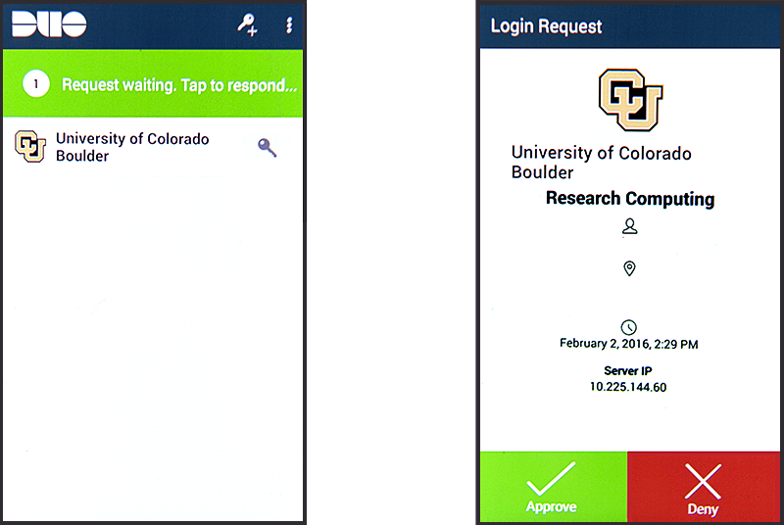
Duo Authentication
After hitting enter your phone will alert you to an incoming Duo authentication.
Open your Duo app and click on ‘Request waiting. Tap to Respond…’.
Next click on ‘Approve’.
You will receive a message informing you authentication was approved and the EnginFrame VDI page will appear (see next slide).
Note: App graphics will vary by phone type.

Slide 24
PetaLibrary Guidelines
Each project should store their data within their project folders
There is no specific limit for data uploads per project
However, we only have 5 TB to share as a group
If you need to store data that is greater than that or a significant portion of that (> 1 TB) please talk to Shelley first
Will discuss proper data organization in our Data Standards training in late July

Slide 25
Moving Data to the PetaLibrary
Globus is our preferred method of data transfer
Designed with researchers in mind
End points between computers make for easy data transfer with an easy to use interface
Endpoints are different locations that data can be moved to/from
Personal or multi-user
Scripting in use also if don’t want to use GUI
www.globus.org

Slide 26
Globus
Preserves the integrity of data
Compares checksums
Resumes data transfer if interrupted
Fast transfer of large data sets
Globus can be set up to easily share data among collaborators
Log in using Identikey:
https://docs.globus.org/how-to/get-started/
Set up an endpoint: https://docs.globus.org/how-to/globus-connect-personal-mac/

Slide 27
Condo Cluster
To access:
ssh login.rc.colorado.edu –l <username>
Password: duo:<identikey password>
ml slurm/blanca
To submit to Earth Lab nodes:
sbatch –qos=blanca-el
To submit to all of blanca:
sbatch –qos=blanca

Slide 28

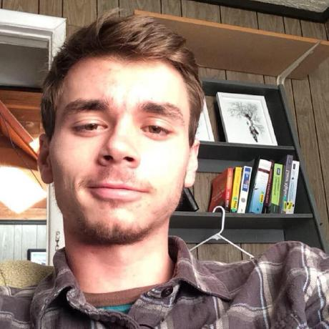
Analytics Hub Code Recipes
Built based on common needs of Earth Lab participants
Jupyter notebooks:
https://github.com/earthlab/tutorials
Website:
earthlab.github.io
Zach Schira Matt Oakley

Slide 29
Remote Visualization Using the NICE EnginFrame Remote Visualization Platform

Slide 30
Practice
Log into our tutorial nodes
tutorial-login.rc.colorado.edu
Grab the data 8947.txt in /lustre/janus_scratch/knuths and move it into your directory
Using the meetup reservation, use Matlab to run the script matlab_test_plot.m
Can we do better?

Slide 31
Going Native
Using native X-tunneling is hard and very slow.
Using native VNC is less-hard, slightly faster but not always available.
Using ‘native’ methods means you are transferring all of your data and updates back and forth so if you are playing with large datasets it could take a very long time for updates.
If working only on a local machine you may not have decent or even required graphic capabilities.
If working on a local machine you probably do not have a copy of your data and if you do it may be to large to run.
Almost impossible to collaborate your work with others.

Slide 32
Remote HPC Visualization
Using remote HPC visualization eliminates the X-tunneling connectivity issues!
Only keystroke and mouse commands travel to the remote desktop and only updated screenshots travels back to the user so vastly less bandwidth issues!
Remote visualization clusters utilize the latest and greatest graphic hardware!
You work right beside your datasets!
You can easily share your work, live, with other users.

Slide 33
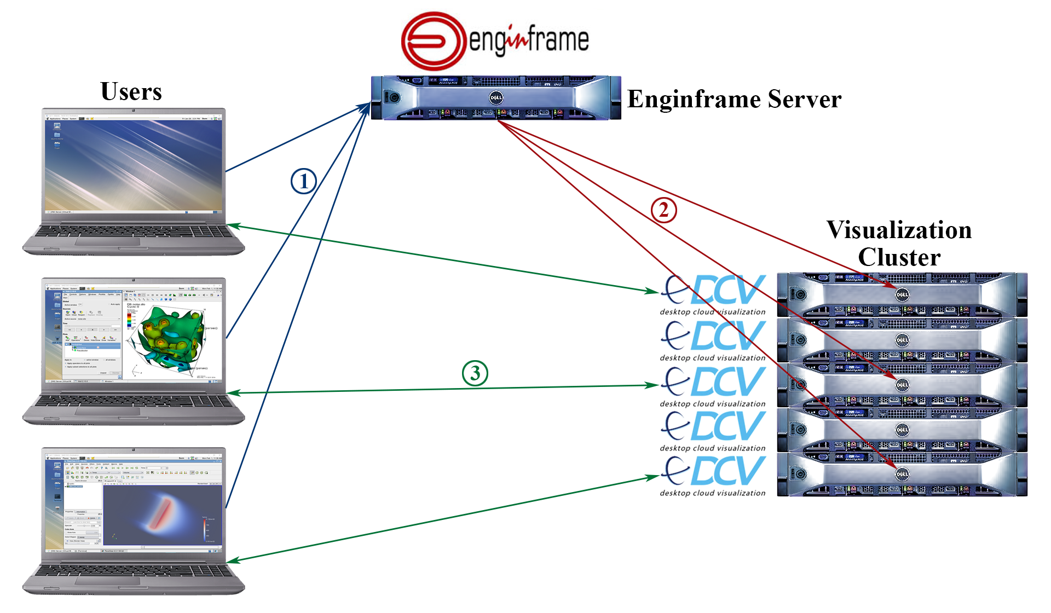
EnginFrame Remote Desktop Architecture
User requests a remote desktop job via EnginFrame.
EnginFrame creates a new job and starts a DCV-VNC session and launches a Remote Desktop.
The user connects to the DCV Remote Desktop and does their desired work. Only keystroke and mouse commands travel to the Remote Desktop and only updated screen shots from the Remote Desktop travels to the user.

Slide 34
Requirements to Use EnginFrame
In order to access the visualization cluster, users must meet the following requirements:
You must have an account with CU Research Computing.
You must have a ‘Duo’ dual authentication account through CU Research Computing.
You must have access to the internet and an internet browser.
You must install the NICE DCV Endstation for your operating system. This can be obtained from;
http://www.nice-software.com/download/nice-dcv-2016

Slide 35
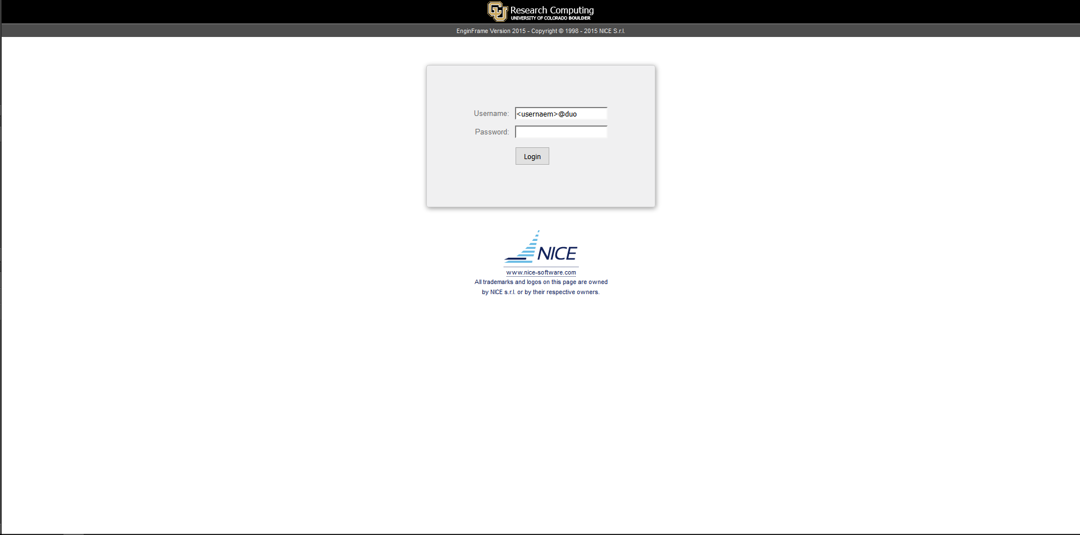
Logging into EnginFrame
From a browser navigate to : https://viz1.rc.colorado.edu/enginframe.
For ‘Username’ enter: <Identikey username>
For Password enter: duo:<Identikey password>.
Click ‘Login’ to begin Duo authentication.

Slide 36
Duo Authentication
After clicking on ‘Login’ your phone will alert you to an incoming Duo authentication.
Open your Duo app and click on ‘Request waiting. Tap to Respond…’.
Next click on ‘Approve’.
You will receive a message informing you authentication was approved and the EnginFrame VDI page will appear (see next slide).
Note: App graphics will vary by phone type.

Slide 37
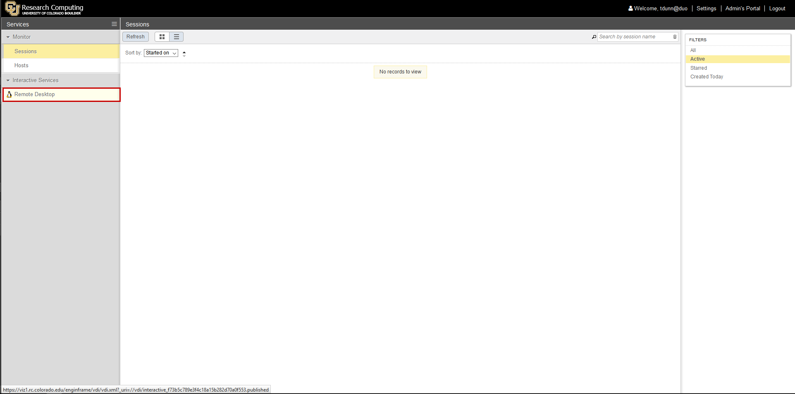
Starting a Remote Desktop Session
To create a Remote Desktop click on the ‘Remote Desktop’ link under ‘Interactive Services’.

Slide 38
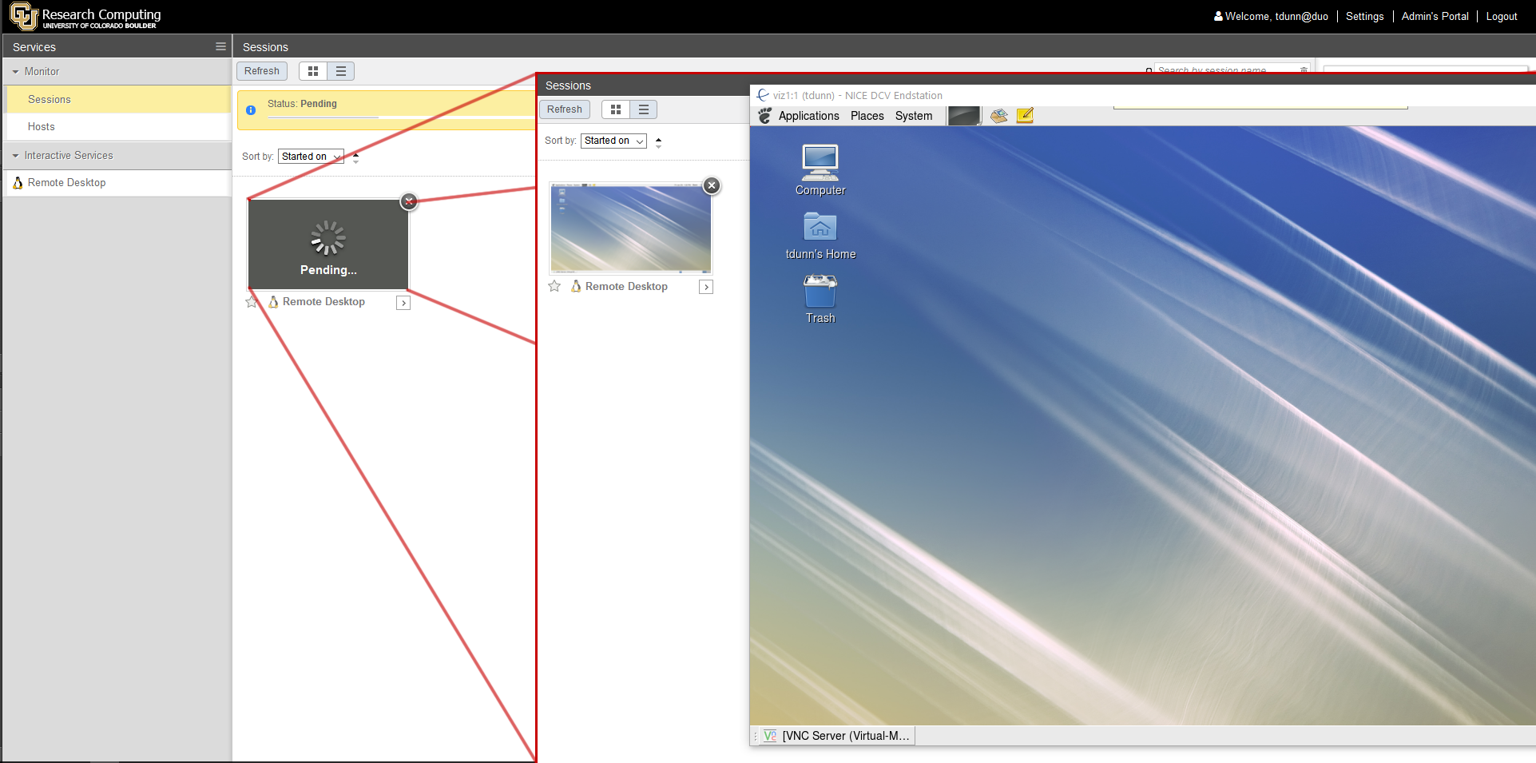
Connecting to a Remote Desktop Session
You will be in a ‘Pending’ status state as you wait for the job scheduler, SLURM, to start a new job on the visualization cluster.
Once a job has started the remote desktop will start and launch your VNC Linux Remote Desktop.
A thumbnail of the remote desktop will be displayed in the Sessions browser

Slide 39
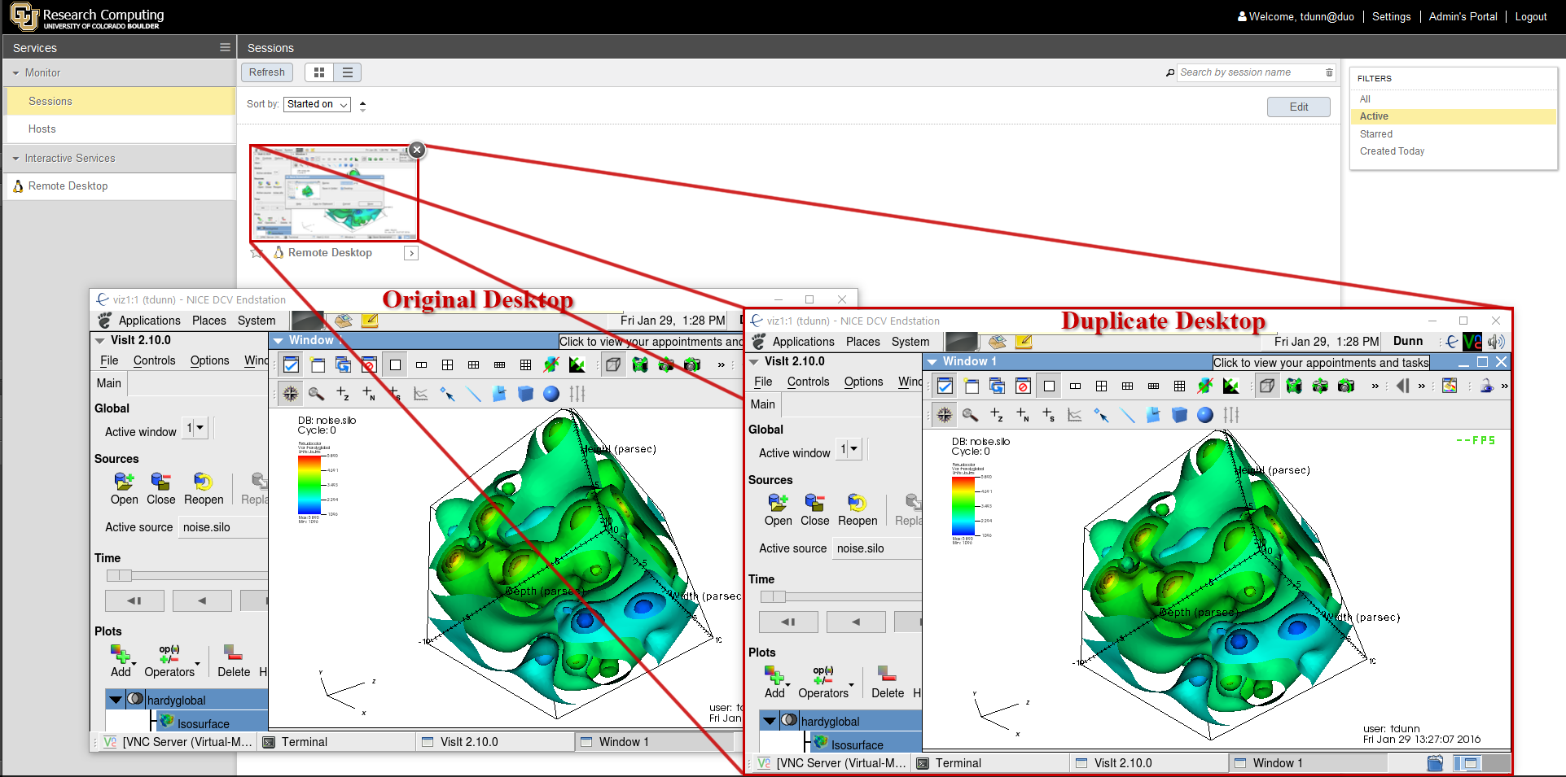
Creating Multiple Concurrent Sessions
By clicking on your ‘Remote Desktop’ in the Sessions browser you can duplicate your ‘Remote Desktop’ session.
Changes you make in one Remote Desktop is reflected in the duplicate session(s).

Slide 40
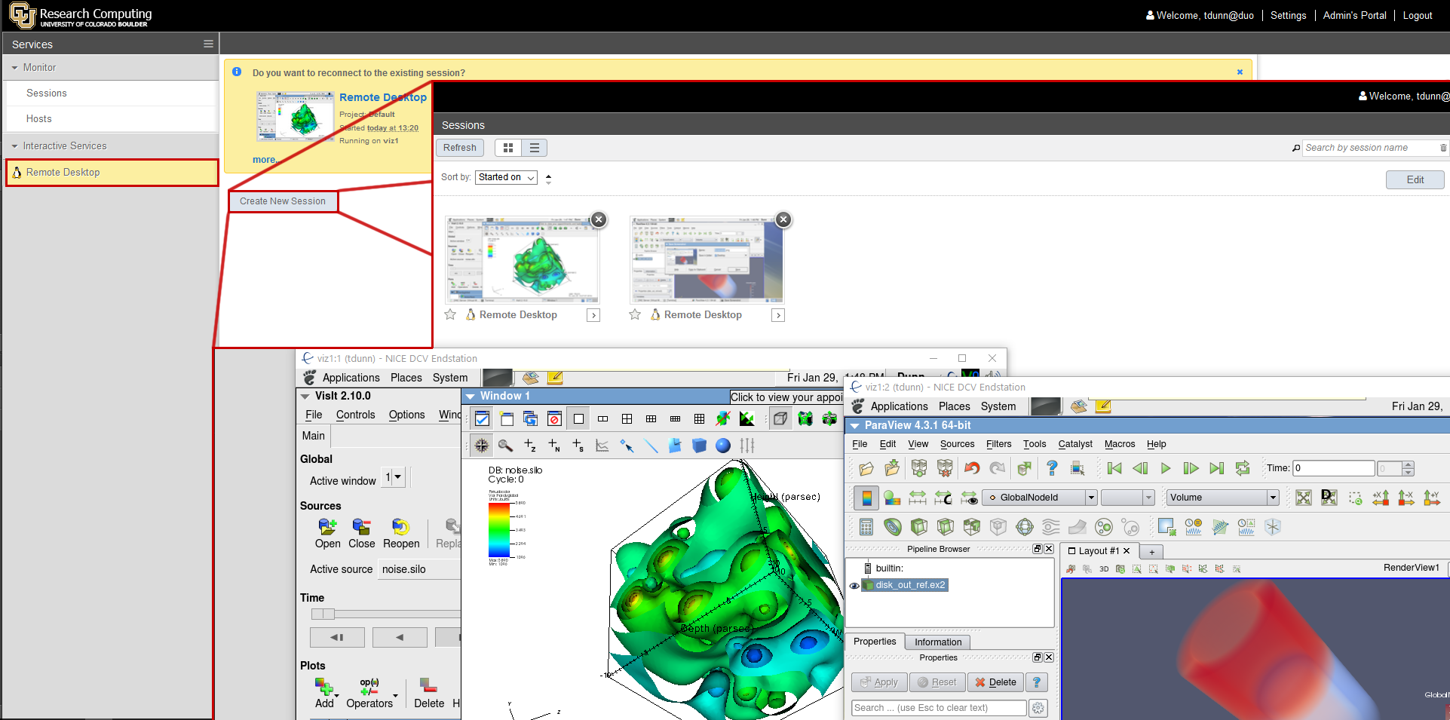
Creating Multiple Separate Sessions
By clicking on your ‘Remote Desktop’ under ‘Interactive Services’ you can create a new, separate ‘Remote Desktop’ session.
Changes you make in one Remote Desktop are NOT reflected in the new session(s).

Slide 41
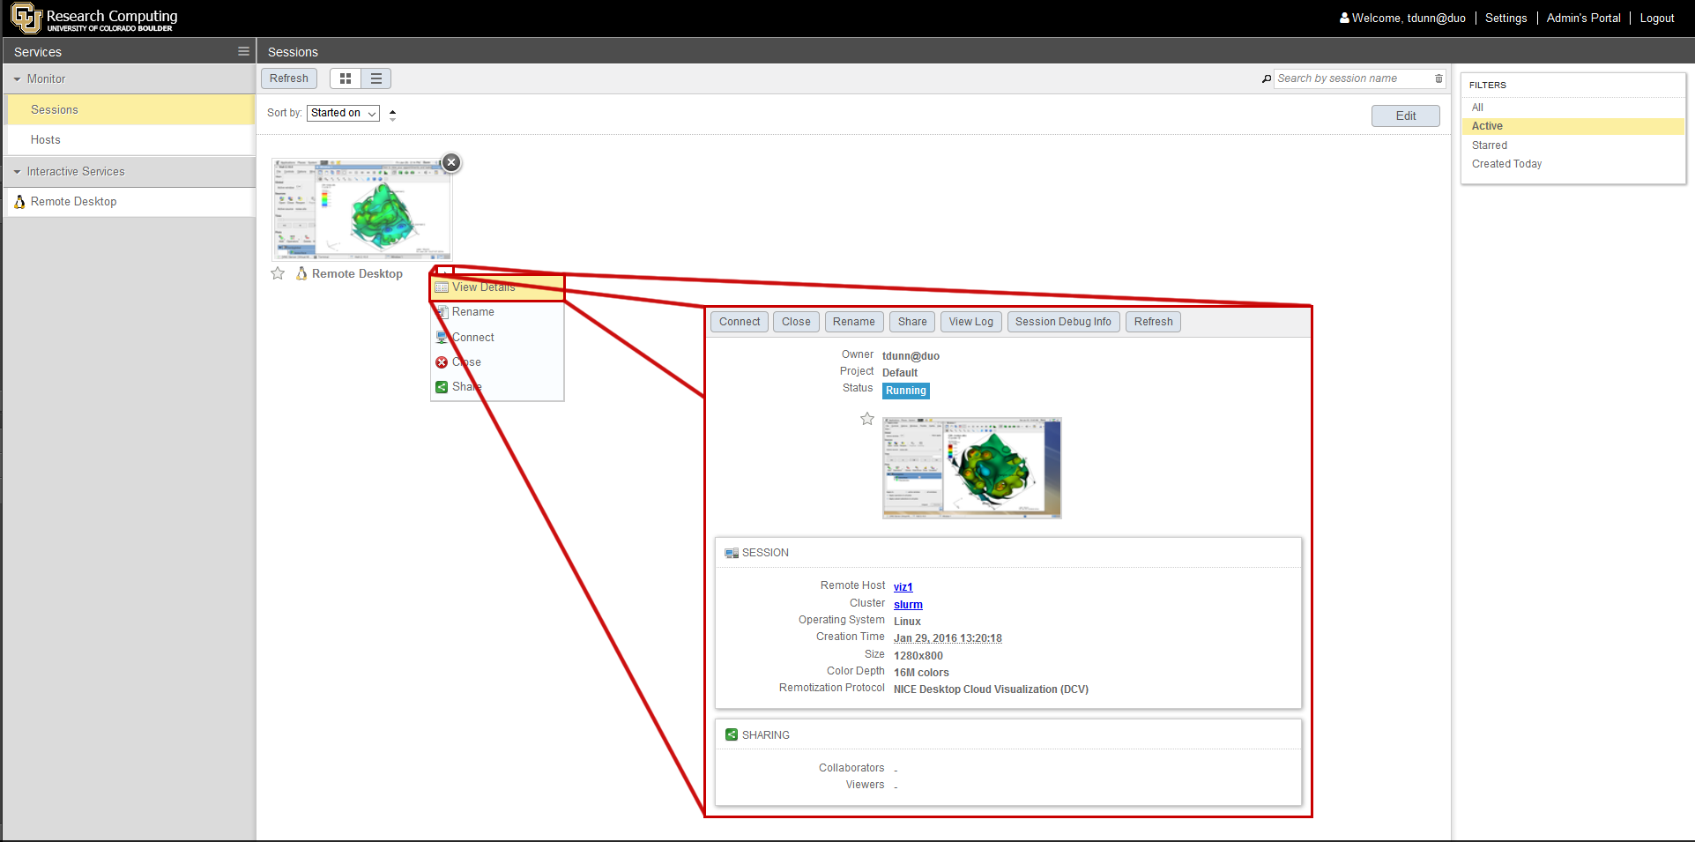
Session Details
Clicking on the arrow next to your ‘Remote Desktop’ will open a hotkey menu.
Selecting ‘View Details’ will send you to the ‘View Details’ page.
The ‘View Detail’ hotkey menu and browser page allows you to ‘Connect’, ‘Close’, ‘Rename’, ‘Share’, ‘View’ logs, and ‘Refresh’ your remote desktop session(s).
You can return to the Sessions browser by clicking on ‘Sessions’ under the ‘Monitor’ service.

Slide 42
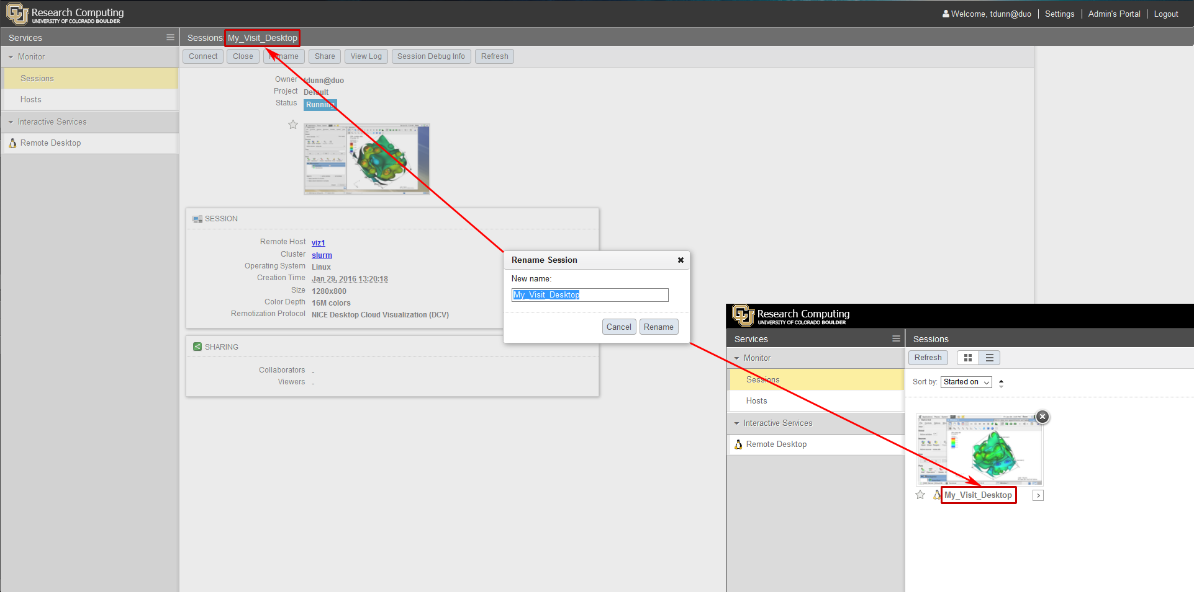
Renaming Sessions
Renaming allows you to change the name of your session so if you have multiple sessions and/or sharing your work with others they an be easily identified.

Slide 43
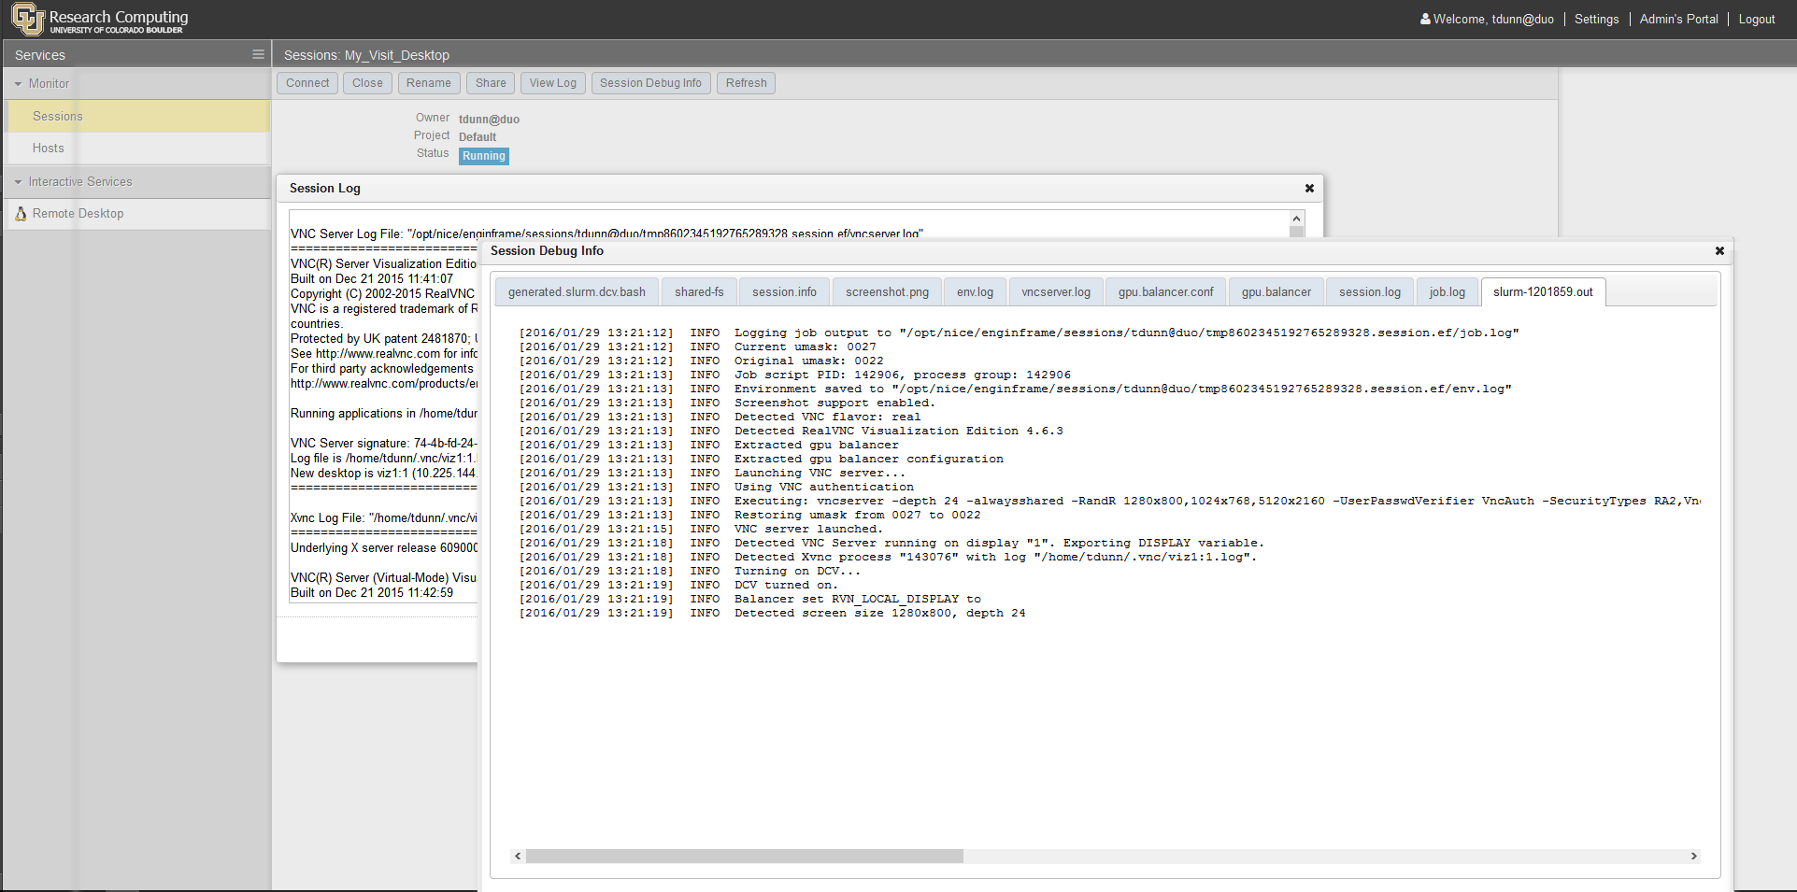
View Logs
The ‘View Log’ and ‘Sessions Debug Info’ selections allow you to look at some of the various logs that EnginFrame generates.
If you run into problems with your sessions and you need to submit a ticket to rc-help@colorado.edu, you may be asked to provide some of this information to help resolve your issues.

Slide 44
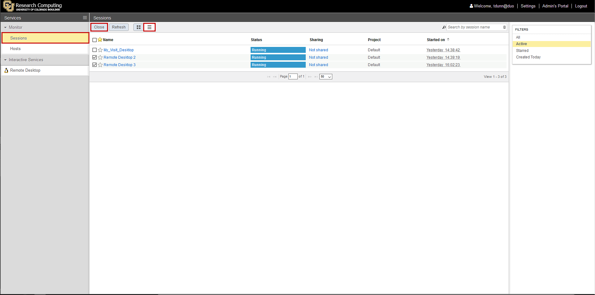
Closing a Session
You can close a session by clicking on ‘Close’ or clicking the ‘X’ button at the top right of a the sessions thumbnail image.
Alternatively, to close one or more sessions at once from the Sessions browser, click on the ‘List’ view icon, choose which session(s) you desire to close and click on ‘Close’.

Slide 45
Session Lifetime
Any remote desktop session you create will be available for a maximum of 24 hours.
During that 24 hour lifetime your session resides fully on the visualization cluster. Thus;
If you close your browser tab or even the browser itself, you can open a new browser/browser tab, log back into EnginFrame and reconnect to your session(s).
If you turn of your machine off or loose power to it you can restart it, log back into EnginFrame, and reconnect to your session(s).
After 24 hours you will loose anything not saved either by you or by an application specific backup file system.
If the visualization cluster looses power or if SLURM issues arise you may loose your session and any work not saved will be lost.

Slide 46
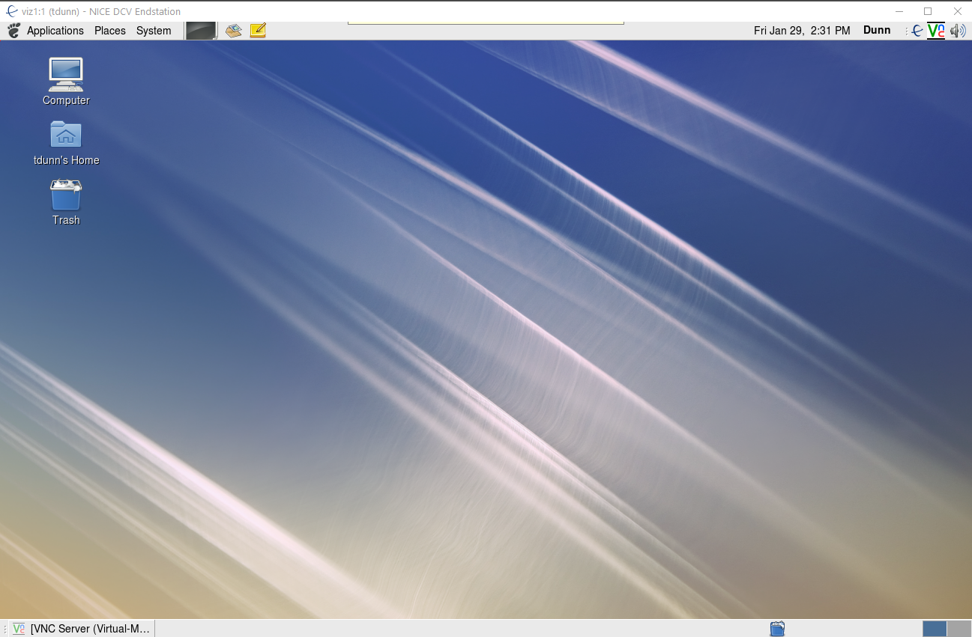
The Remote Desktop
When your Remote Desktop starts you will have a new DCV desktop running Redhat Linux with a slim Gnome desktop.
You will automatically be set to your default CURC home directory running what ever environment you have set up.

Slide 47
Running a Visualization Application
To run a visualization application on the visualization cluster you may use either the ones installed on Janus (or Summit in a few months) by loading the appropriate module and then launching it.
It is important to note that only the new LMOD module system will be accessible from the visualization cluster. If you already have an account on Janus then you just need to open a terminal window, making sure you are in your home directory, and typing;
touch ~/.lmodrc.lua
Next restart your terminal session and you will now be setup to access LMOD modules.
If you have your own visualization application installed on Janus (or Summit) you can just start it as defined by how you setup your installation of the application.

Slide 48
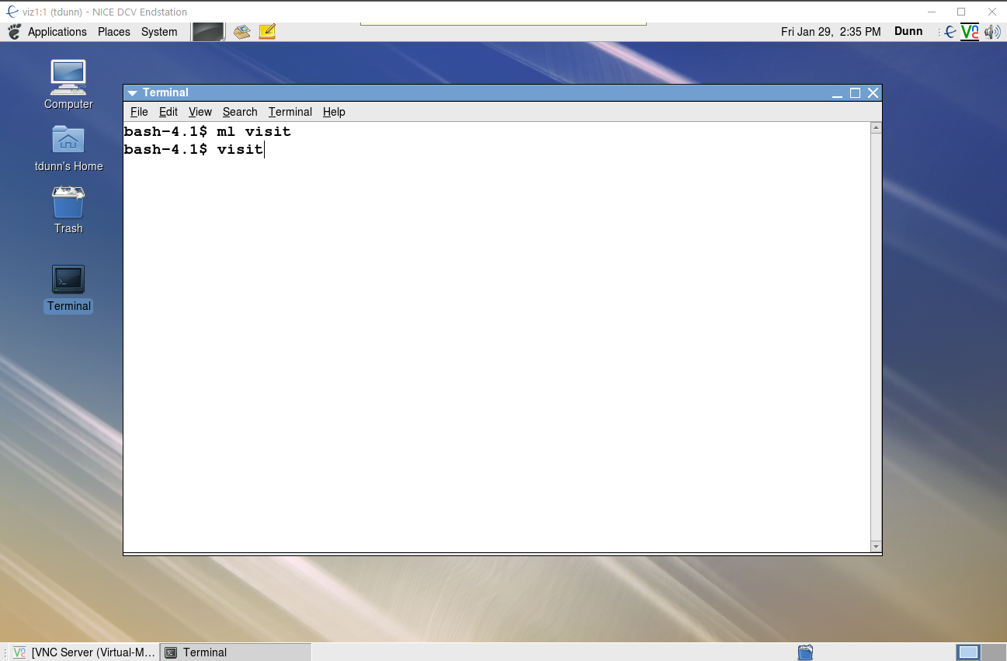
Running a Visualization Application
To start a visualization application (e.g. Visit), open a terminal window and type the following commands.
ml <name of module> where ml is LMOD’s shorthand for module load.
<name of application to run>

Slide 49
What NICE is and What it isn’t
It is:
A place to visualize data easily without knowing how to run jobs on a supercomputer.
Faster and easier than x-tunneling.
Easy to work with data because your data is next to you.
Provides a collaborative working environment.
It’s one component of several parts of the Analytics Hub.
What it isn’t:
A place where plots are magically created
You still need to know your software!

Slide 50
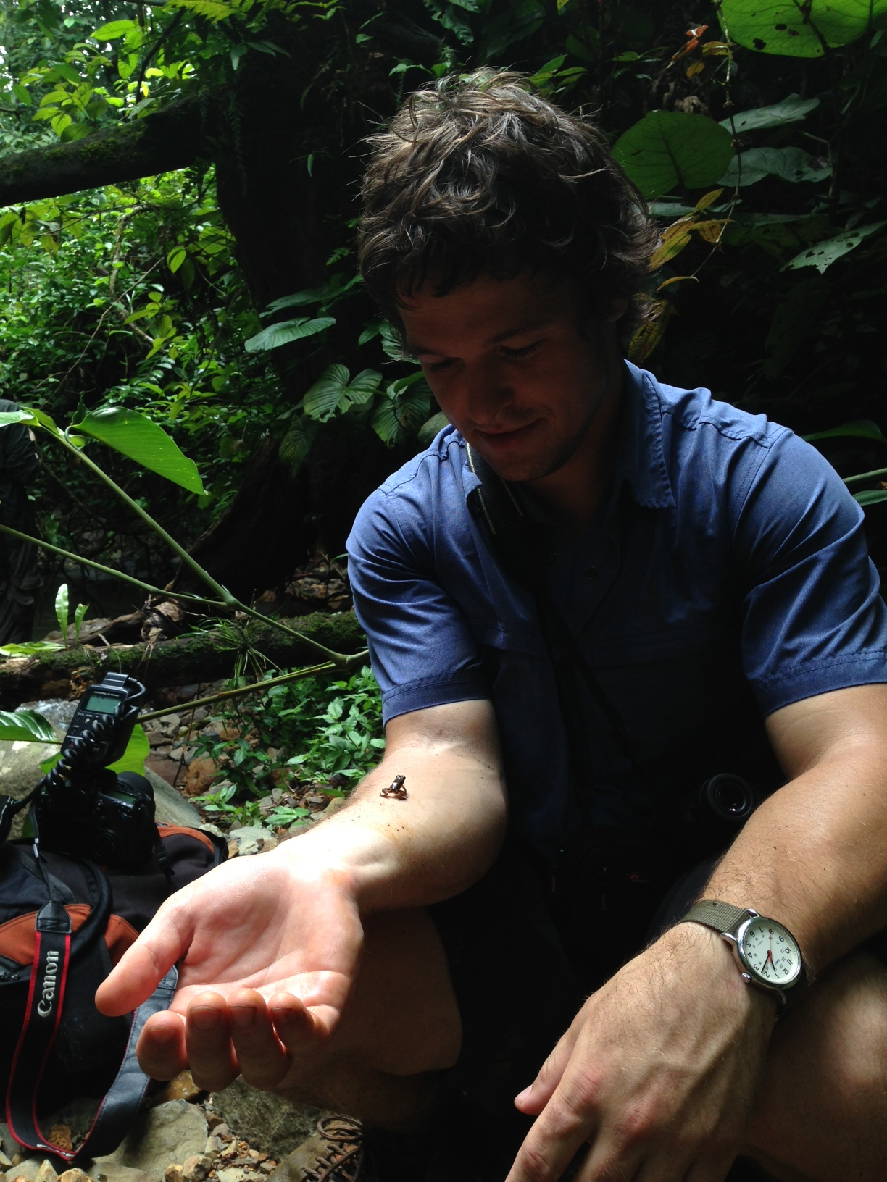
Getting Help
Come to us with questions on:
I need help with my script!
My script is running too slow…can it go faster?
I need to code a task, but don’t know how
Can you make my visualization better?
How do I access this resource?
…
When in doubt, ask!
Credit: Max Joseph

Slide 51
Getting Help
Two methods of asking:
Ticket system
Send an email to el-help@colorado.edu
Will enter a ticket into our system
Best for us since once we talk to you we will submit a ticket anyway
Office hours!
Tim and Max are holding office hours in their Earth Lab office
Wednesdays, 1-2 pm
Stop by!

Slide 52
Questions
Office hours, trainings, etc are on Earth Lab’s calendar
We keep it up to date!
And feel free to connect with us any time – we love to hear from you!
Questions? Shelley.Knuth@colorado.edu
Survey:
http://tinyurl.com/curc-survey16

